Slide 1





Personalization of Learning Resources FOR STEM Education
Valentina Terzieva¹ Elena Paunova-Hubenova¹, Boyan Bontchev²
¹Institute of Information and Communication Technologies, Bulgarian Academy of Science
²Faculty of Mathematics and Informatics, Sofia University “St Kliment Ohridski”
IEETeL June 25-27, Lille, France

Slide 2
Agenda
Introduction to STEM
Research publications about STEM education
Personalized education
Personalized STEM education
A taxonomy of personalization of learning resources applicable in STEM education
Approaches for player-centric personalization in games for STEM
Example – personalization of STEM video games
Conclusions

Slide 3
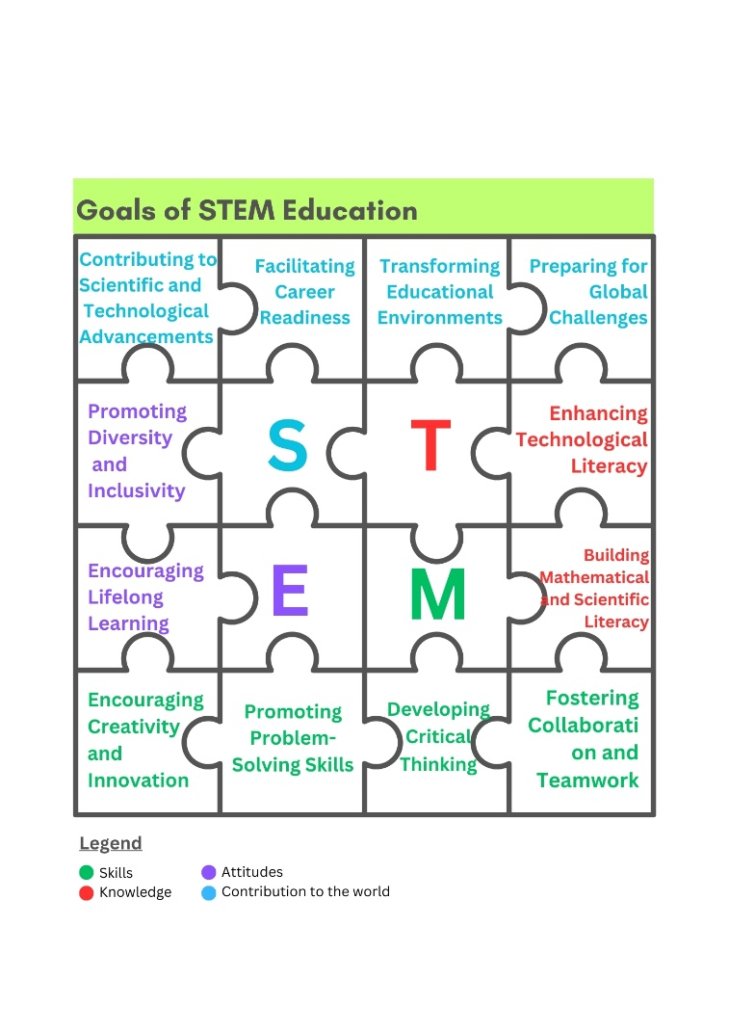
Introduction to STEM
STEM – Science, Technology, Engineering, and Mathematics
STEM education promotes:
creative and innovative thinking
critical thinking and problem-solving
communication and collaboration
information management
effective and efficient use of technology
career and life skills, cultural awareness, etc.

Slide 4
Publications About STEM education (2010 – 2024)
Scopus
Web of Science

Slide 5
STEM in SCOPUS and WoS by countries
WoS
Scopus

Slide 6
STEM in SCOPUS and WoS by Type of Publication
WoS
Scopus

Slide 7
STEM in SCOPUS and WoS by areas
WoS
Scopus

Slide 8
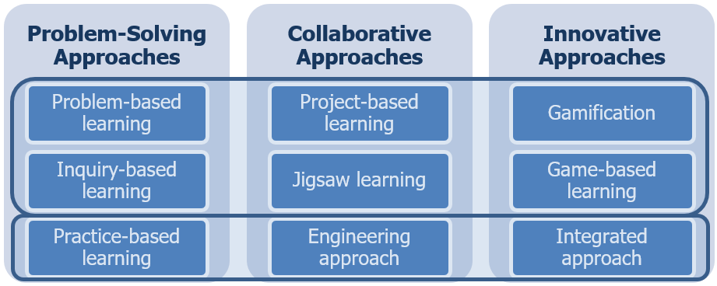

STEM teaching methods
Single approaches
Multi- approaches

Slide 9

Personalized education
Personalized education is a didactic approach “designed and paced to match students’ learning needs; adjusted to meet their learning preferences; and sensitized to their specific interests, backgrounds, and experiences.” (J. Gupta)
“Personalized learning is finding what each child needs to be successful and using that learning opportunity to help the student become more proficient.” (Ken Schofield)
“A progressively student-driven model where students deeply engage in meaningful, authentic and rigorous challenges to demonstrate desired outcomes.” (Zmuda, Curtis and Ullman, 2015)

Slide 10
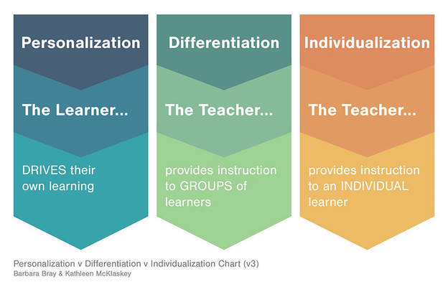
Personalization vs Differentiation vs Individualization

Slide 11
Personalization approaches
Three approaches to personalization of learning (Bray & McClaskey, 2012):
Individualized training – usually aimed at learners who need specific support or those with SEN
Differentiated (group) learning – grouping learners based on their levels of knowledge, skills or interests; tailored training approaches to match the characteristics or preferences of the groups of learners, same educational objectives, differentiated curriculum
Personalized learning – focused on the learners needs, knowledge level, interests, and preferences; learners have a decisive role in setting learning goals and choosing the most suitable way of learning

Slide 12
Personalized learning: when?
Implementation of personalized approaches during the teaching process:
Static: pre-set personalization done by fixed rules
Dynamic: on-the-fly correction/tuning of the personalization method based on learner feedback/report
Hybrid approaches

Slide 13
Personalization Approaches for STEM Education
Individualized training – usually aimed at learners who need specific support or those with special education needs (SEN). Individualization tries to provide explicit instruction based on the learning needs of each particular learner and, thus, accommodates the learning needs of the individual.
Differentiated (group) learning – grouping learners based on their levels of knowledge, skills, or interests; it provides a differentiated curriculum tailored to the characteristics or preferences of groups of learners having the same educational objectives.
Personalized learning – focused on different objectives, needs, knowledge levels, interests, and preferences of each learner; learners have a decisive role in setting learning goals and choosing the most suitable way of learning.

Slide 14
Personalization of Learning Resources for STEM 1/6
Curriculum-based resources – structured lessons, often aligned with educational standards, presented in textbooks, lesson plans, workbooks, curricula frameworks, or blended narrative and storytelling.
Digital resources – include interactive and often self-paced tools for learning, such as simulations, educational videos and audios, didactic multimedia les-sons, etc.
Online platforms – represent interactive and usually self-paced learning tools, offering online courses (e.g., Khan Academy and Coursera), virtual labs, coding platforms (like Scratch and Tynker), and learning management systems (such as Google Classroom and Moodle).

Slide 15
Personalization of Learning Resources for STEM 2/6
Hands-on, open-ended tasks or experiential resources – often used for real-world-based STEM activities. They can involve various science and robotics kits (e.g., LEGO Mindstorms and Arduino) and equipment. Usually, they are applied in engineering projects and experiments performed within maker space environments or laboratories. These activities require instructions integrating multiple STEM disciplines using cross-curricular project materials to provide a holistic learning experience.
Print materials – include physical or digital reading resources, such as books, magazines, STEM encyclopedias, infographics, and posters. These resources can be used in STEM methods with elements of students’ self-training in or out of class, like inquiry-based learning or a flipped classroom.

Slide 16
Personalization of Learning Resources for STEM 3/6
Games and virtual environments – include educational tools that teach STEM through play or challenges, like educational video games; virtual environ-ments often integrate virtual reality (VR) and augmented reality (AR) to pro-vide immersive experiences that bring STEM concepts to life, and virtual sim-ulations (e.g., PhET Interactive Simulations).
Application and mobile tools – this group includes STEM learning apps for smartphones and tablets, such as math and science apps (sometimes enhanced by AR/VR extensions), mobile games, flash cards, quizzes, and many more.

Slide 17
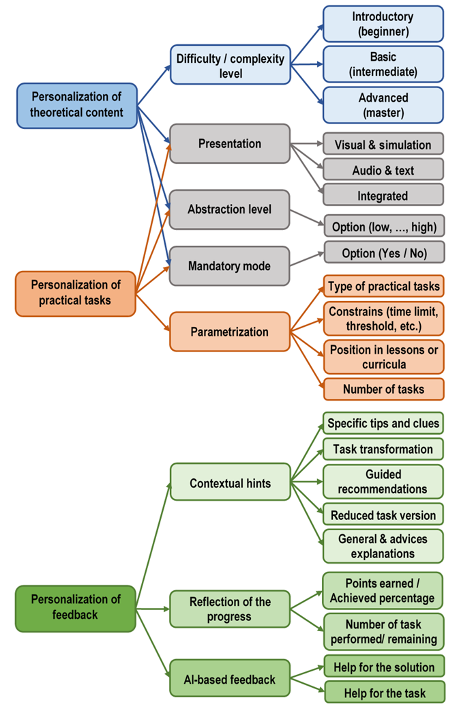
Personalization of Learning Resources for STEM 4/6
A taxonomy of personalization of learning resources applicable in STEM education

Slide 18
Personalization of Learning Resources for STEM 5/6
A taxonomy of personalization of learning resources applicable in STEM education (cont.)

Slide 19
Personalization of Learning Resources for STEM 6/6
A taxonomy of personalization of learning resources applicable in STEM education (cont.)

Slide 20
Approaches for player-centric Personalization in games for STEM
Personalization approaches | Player model characteristics | Examples
Difficulty level | Initial knowledge Game outcomes Playing speed and efficacy Emotional state | Static complexity level set by initial knowledge Dynamic difficulty adjustment changed by outcomes, speed, and/or emotional state or arousal
Presentation type | Learning style Playing style | Choice of visual, auditory, textual, or kinesthetic resources [ Resources for different types of players
Abstraction level | Age, Initial knowledge | Choice of short or extended abstract didactic content
Mandatory mode | Goals and preferences | Mandatory or optional mini-games situated in a maze hall
Parameterization | Any | The threshold for passing a quiz level Type and number of mini-games situated in a maze hall
Contextual hints | Any | How-to-play instructions for didactic tasks in video games Hints for a specific problem in gameplay
Progress tracking | Game outcomes Acquired knowledge Playing speed and efficacy | The percentage of completing a mission or quest Log record with results achieved in quizzes Time, score, and efficacy of trials to hit a target
Intelligent feedback | Game outcomes Acquired knowledge | AI-generated feedback about knowledge acquired in the game or how to complete a didactic task in the game

Slide 21
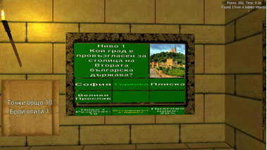
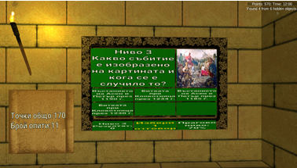
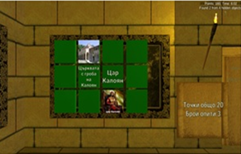
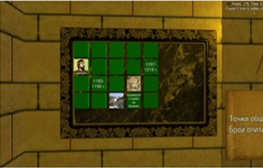
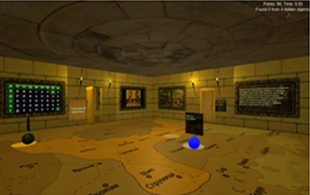
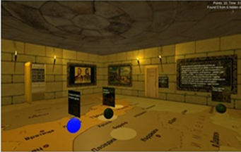
Example: Universal and Personalized Versions of an educational video Game

Slide 22
CONCLUSIONS
Evolution of traditional personalization approaches
AI-based personalization
Personalized curriculum design
Enhanced accessibility
Predictive analytics
Dynamic content delivery
Cognitive tutoring systems offer individualized support, improving perception and critical thinking abilities

Slide 23
Thank you for your attention!
valentina.terzieva@iict.bas.bg
elena.paunova@iict.bas.bg
bbontchev@fmi.uni-sofia.bg
Acknowledgments
This research is supported by the Bulgarian National Science Fund through the projects
“MOdeling inTelligent Instruments for adaptIVe and personAlized educaTional STEM video gamEs” (MOTIVATE), contract No. КП-06-Н85/2 from 05.12.2024 and
“ReSearcH on formAl models for the oPtimization and pErsonalization of modern technological methods of STEM education” (SHAPES)” contract No. КП-06-Н75/11 from 08.12.2023

Slide 24
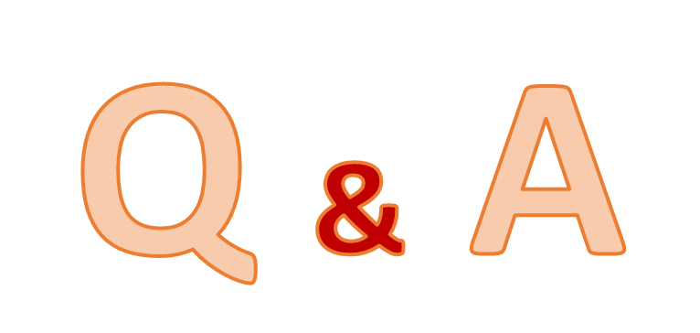
Questions?
Contacts:
valentina.terzieva@iict.bas.bg
elena.paunova@iict.bas.bg
bbontchev@fmi.uni-sofia.bg
http://shapesproject.eu/
http://motivateonline.eu/

